Slide 1


INRODUCTION TO BASIC MICROBIOLOGY, BIOCHEMISTRY & INDUSTRIAL BIOTECHNOLOGY (IMBoIB)
DEVARAI SANTHOSH KUMAR
Biological Engineering
Slot: : CH2110

Slide 2
OUTLINE OF IMBoIB (BE)
Introduction
Biotechnology- Important developed field
Application of Biotechnology- Interdisciplinary
Development of Bio-product
Basic Metabolism and Catabolism Pathways
Theory
Equation derivation
Problem solving
Biochemistry, Structure of DNA, RNA
Protein Synthesis
Bioenzymes kinetics (Growth and Enzyme)
Fermentation development
Downstream purification
Mass Transfer in bioprocessing
Rheology of fermentation broth
Oxygen demand, types
Bioreactor and Fermentation
Recombinant monoclonal technology
Marine-derived biomaterials, Pharmaceutical, Molecular biology, System biology and Tissue engineering
Text Books
Se-Kwon Kim: Marine Biomaterials: Characterization, Isolation, and Applications, CRC Press
Blanch , Biochemical Engineering, Second Edition, CRC Press
Bailey and Ollis: Biochemical Engineering Fundamentals, McGraw-Hil
Bioprocess Engineering: Basic Concepts, by Michael L. Shuler, Prentice Hall, 2001
Net Source
End-Exam and Assignment collection (Tentative date)

Slide 3
Basic Biotechnology: Its an multi-disciplinary, it combines applied science and engineering for any living organisms or substances from those organisms to make or modify a product, to improve plants or animals or to develop microorganisms for specific uses.
Animal Agricultural
Plants for Crop
Basic Biotechnology
Industrial drugs
Food and Beverage processing
Animals
Nanotechnology
Energy and
Environments
Health/Medicine and Pharmaceuticals

Slide 4
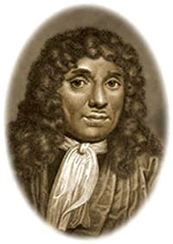
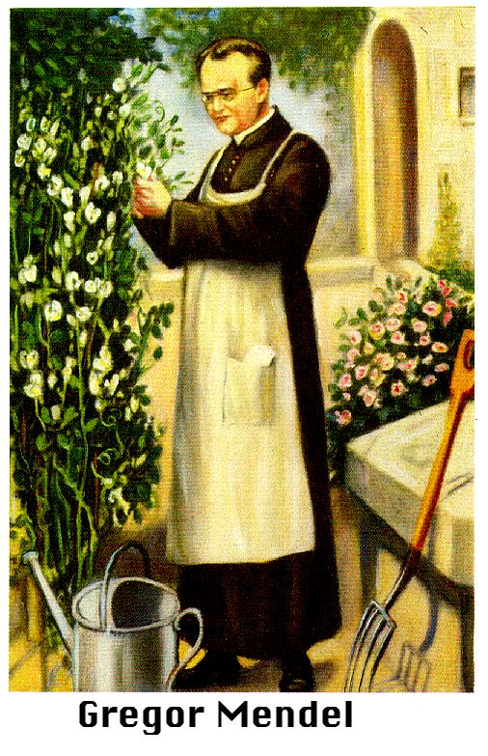
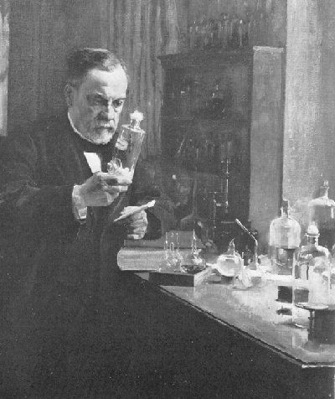
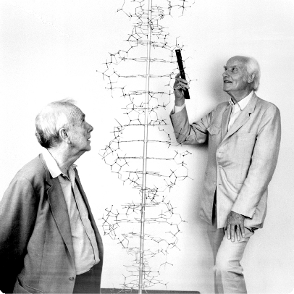
Antony van Leeuwenhoek
Few Nobel laureate discovered biotech revolution to current existence.
1675, Discovers bacteria using a simple microscope
Gregor Mendel- founder of genetics
1863, Austrian monk who conducted the first genetics experiments using pea plants in the mid 1800s.
Louis Pasteur
1870’s, describing the role of bacteria in spoilage and the scientific basis for fermentation and created the rabies vaccine
James Watson & Francis Crick
1953, discovery the double helix structure of DNA using X-ray photographs

Slide 5
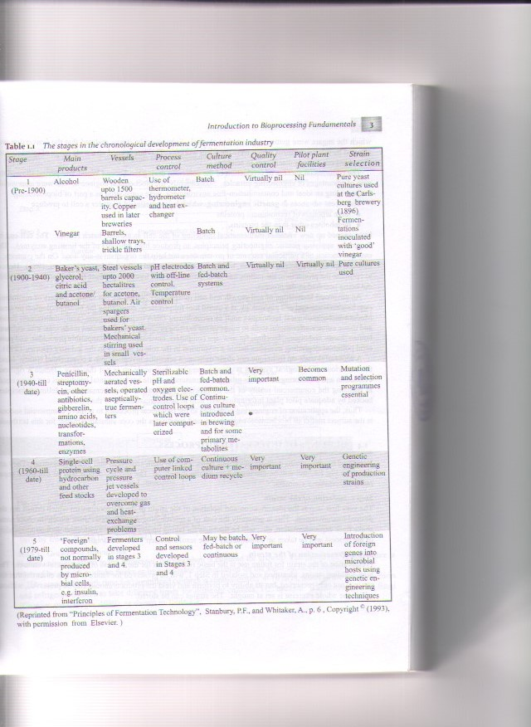
Latest Advances in the Biotechnology
Cloning
DNA fingerprinting
Genetically modified bacteria to synthesize products
Genetically modified foods

Slide 6
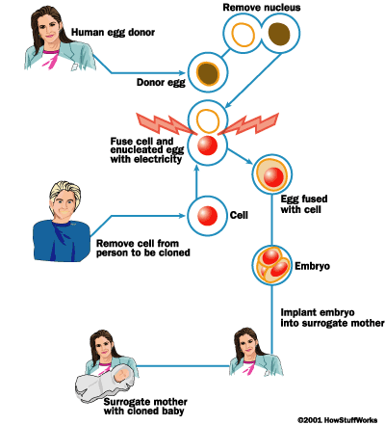
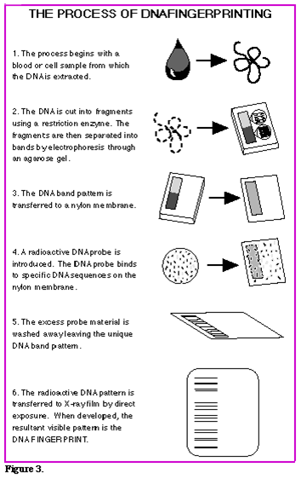
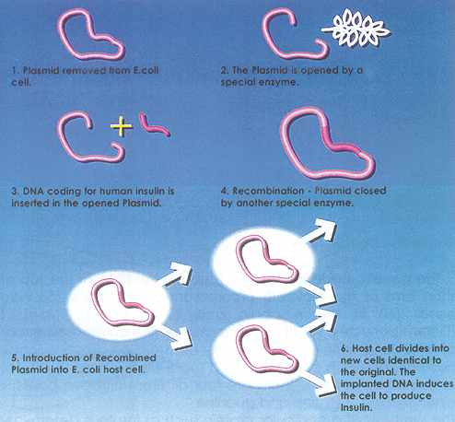
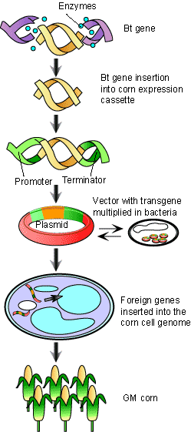
Genetically modified bacteria to synthesize products
Genetically modified foods
Cloning
DNA Finger Printing

Slide 7
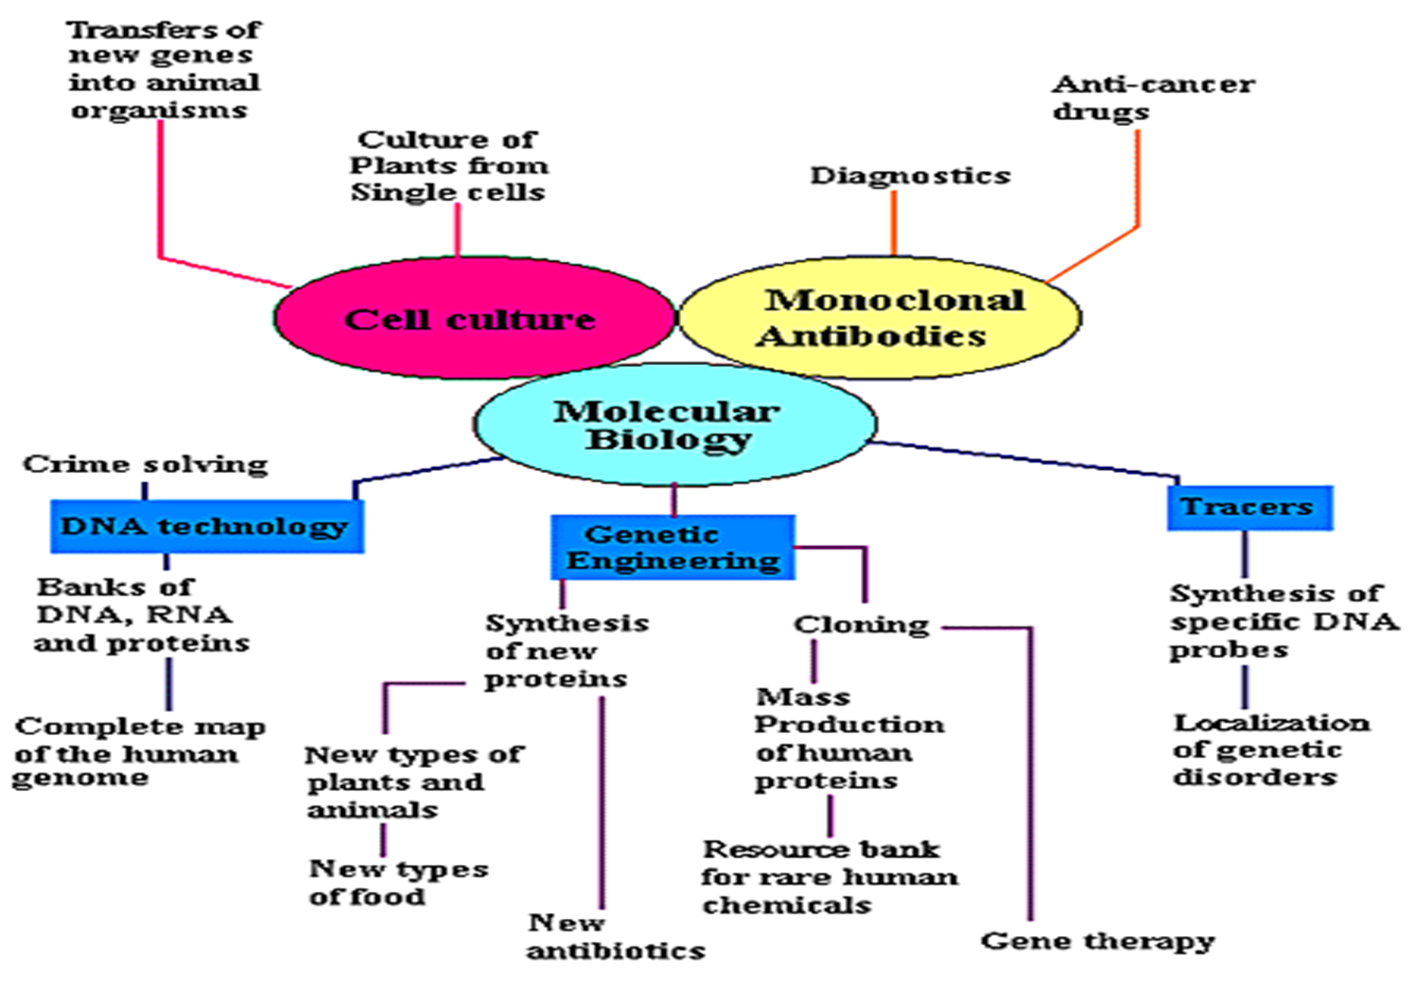
Current and Future Biotech Applications

Slide 8
Outline of Bioprocess Process View

Slide 9
Step 1: Isolation of the strain
Step 2: Preservation of the strain
Upstream
Step 3: Growth of inoculums
Bio-products
Step 4: Prefermentation culturing
Step 5: Fermentation
Fermentation
Step 6: Recovery and Purification of the product
Downstream
Step 7: Treatment of Effluents

Slide 10
Example Fungal Stain
L-Asparaginase
Isolation of the strain Fungal Stain

Slide 11
Isolation of fungal microorganism
Samples ( soil samples from relevant sources)
1 gram of sample mixed with 10 ml of saline
Vortexed and incubated for 15 min
From this 1 ml taken in eppendorf and serial dilution was done upto 10⁶
100 micro liters from it spread plated
Incubated at 30 ºC, pH – 7

Slide 12
L-asparaginase screening from fungal strains (Gulati et al., 1997)
PLATE ASSAY
L-asparaginase production is accompanied by increase in pH of the culture filtrates
(ammonia is released as asparagine is hydrolyzed)
pH indicator phenol red is incorporated in the medium containing asparginine (as sole nitrogen source)
Phenol red at acidic pH is yellow and at alkaline pH is pink
Pink zones are formed around microbial colonies producing L-asparaginase

Slide 13
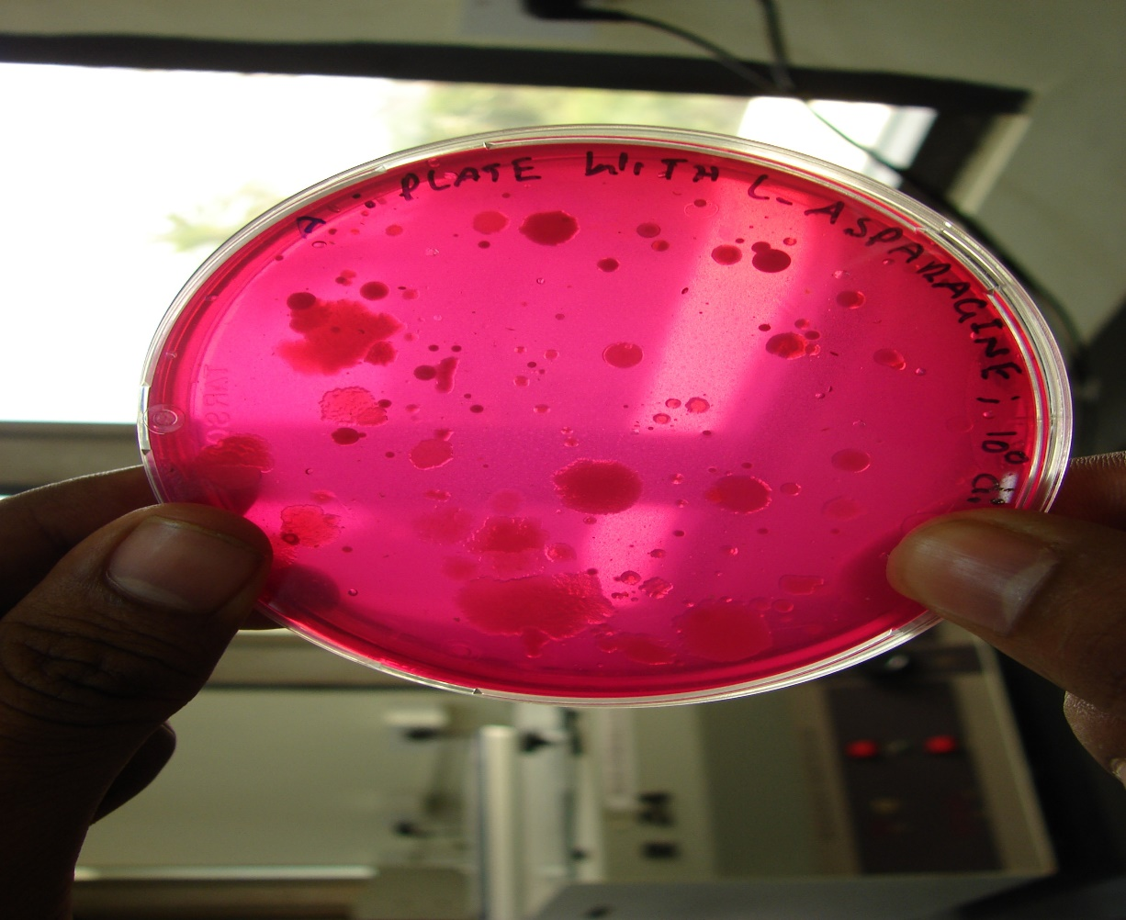
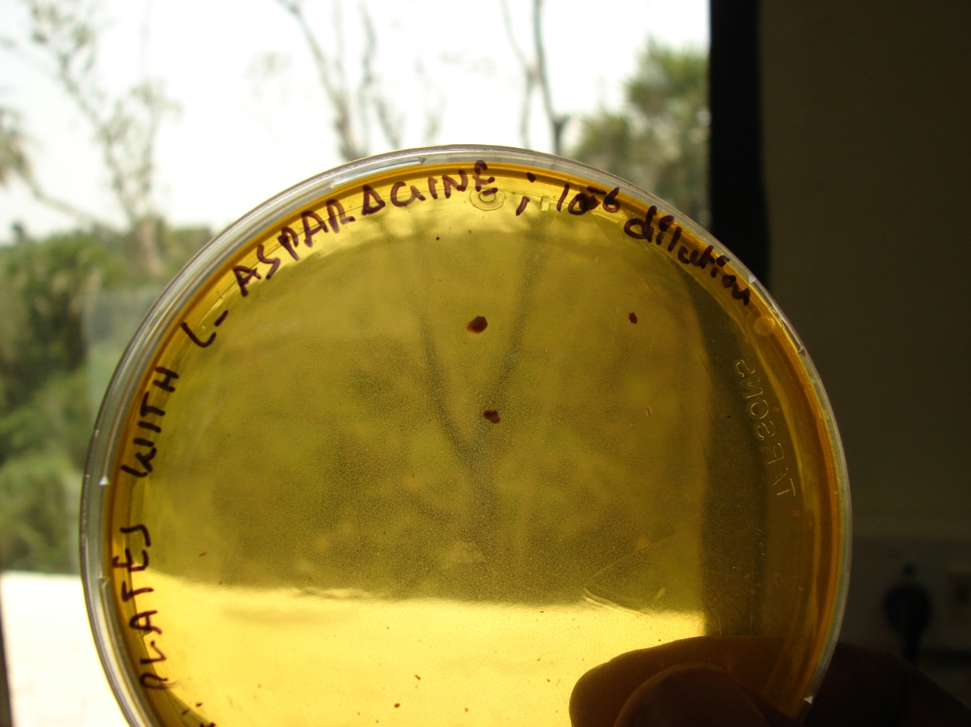
Asparaginase screening with asparagine and with out asparagine
Example

Slide 14
Lacto-phenol staining : (Amann.J,1896)
Phenol (pure crystals)…………10 g
Lactic acid (syrup, s.g.1.21)…..10 g
Glycerol (pure)…………………..20 g
Distilled water…………………...10 g
Procedure:
Lacto phenol is readily prepared by warming the phenol with the water until dissolved and then adding the lactic acid and glycerol.
Lacto-phenol advantage:
For mounting medium it rarely causes shrinkage or swelling of the cells of most fungi
It has no tendency to evaporate and preparations are reasonable permanent.
Identification of fungal strains: Smith’s Introduction to Industrial Mycology

Slide 15
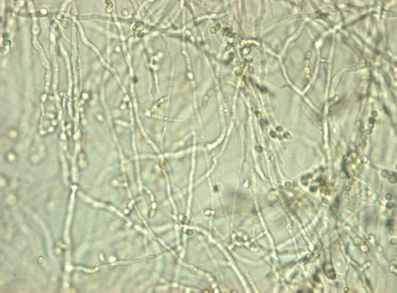
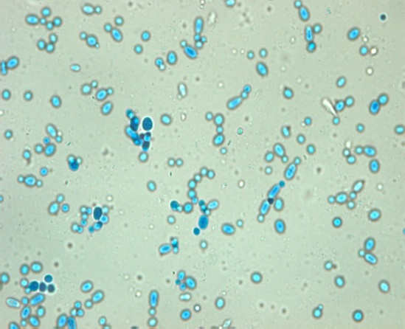
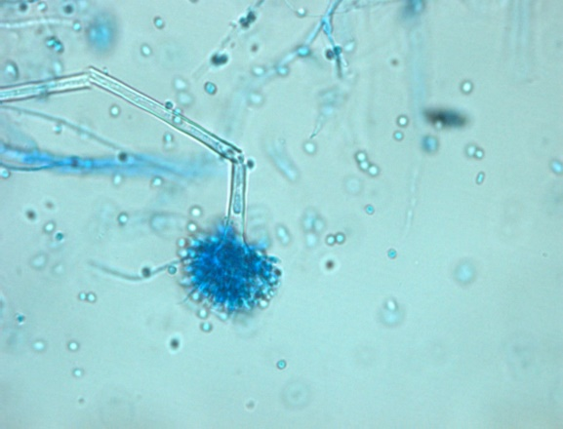
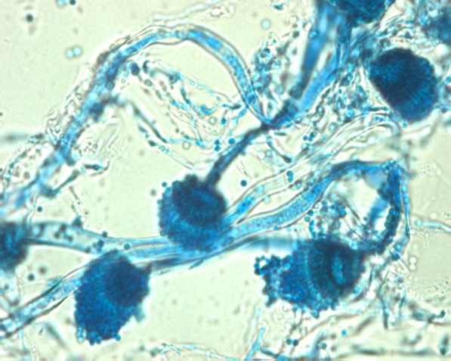
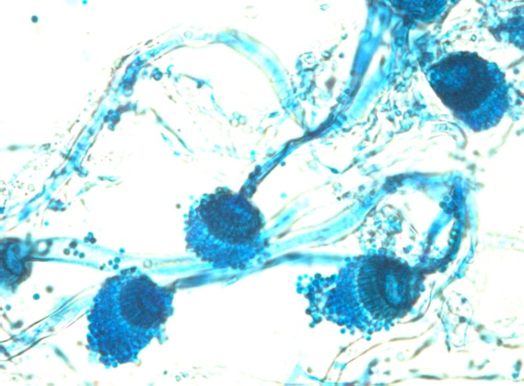
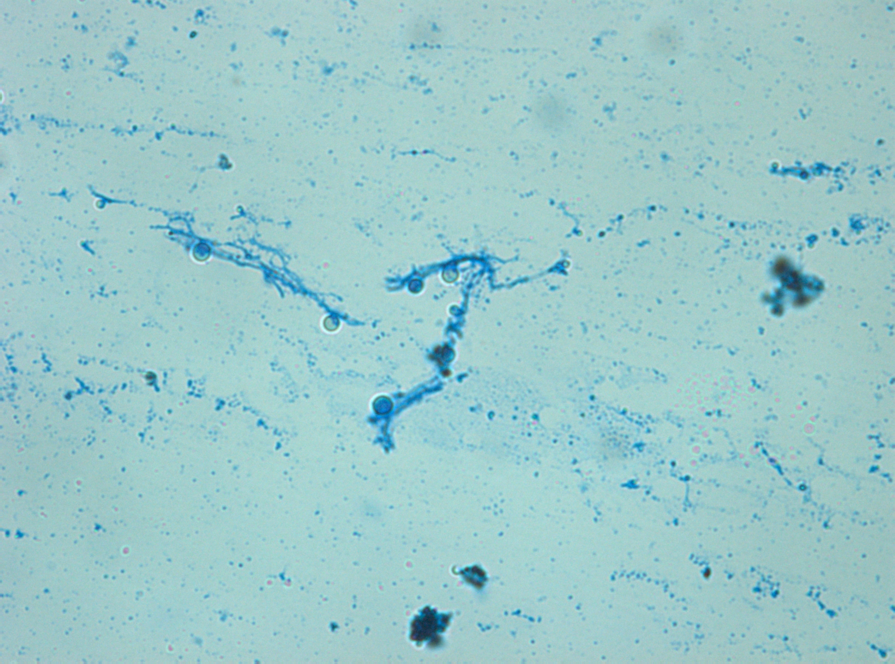
Trichoderma species_20x
Trichoderma species_40x
Byssochhlamys species_20x
Cladosporium species_20x
A.fumigatus_40x
A.fumigatus_20x
Smith’s Introduction to Industrial Mycology-Seventh Edition

Slide 16

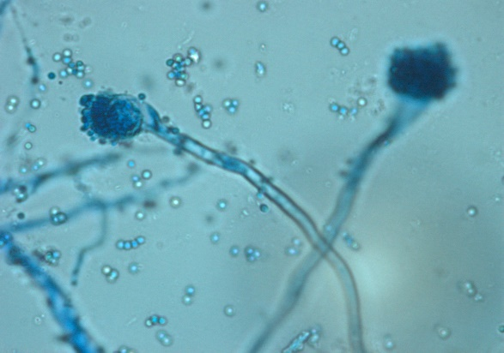
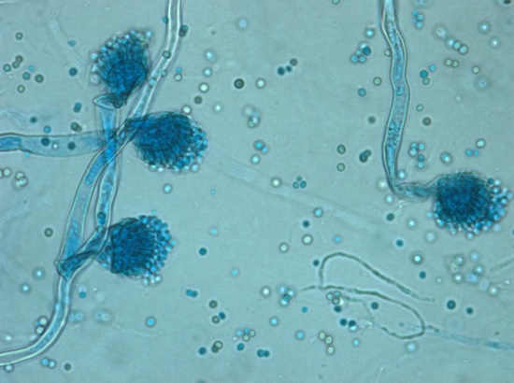
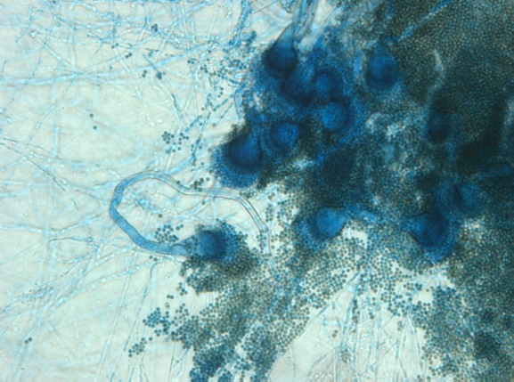
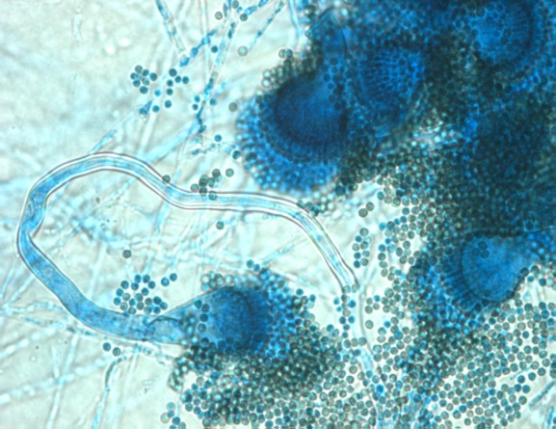
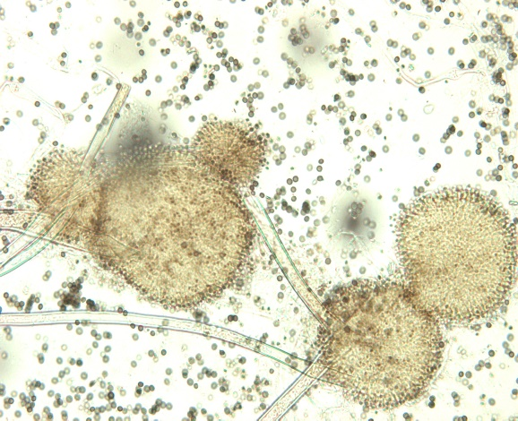
A.fumigatus_20x
Byssochhlamys species_40x
A.fumigatus_40x
A.Niger_20x
A.niger_40x
A.niger_20x
Smith’s Introduction to Industrial Mycology-Seventh Edition

Slide 17
Initial observation on fungal colonies:
S.NO | NOMENCLATURE | CHARACTERSTICS
1 2 3 4 5 6 7 | S1051 S1052 S2051 C3051 C3052 C4051 C4052 | Flat, transpose, Serrated margin Large, spreading, transpose, spore presence Flat, transpose, raised, serrated margin Without spore, mycelium form, small With spores Spin head flat circular, round Irregular flat, irregular margin
1 2 3 4 5 | S1121 S1122 S2121 C3121 C4121 | Small, circular shape Big, circular shape Minute circular shape, flat Flat, transpose, serrated margin Flat, irregular, small

Slide 18
Example Bacterial Stain Caffeine demethylase and degradation
Isolation of the Bacterial Stain

Slide 19
Specific medium:
Caffeine + Ampicillin Medium: (No Sucrose) (Hakil.M et al.,1998)
KH₂P04 : 1.3 g/l
Na₂HPO₄ : 0.12 g/l
MgSO₄7H₂O : 0.3 g/l
CaCl₂2H₂O : 0.3 g/l
Caffeine : 0.5 & 1.2 g/l
Agar : 20 g/l
Ampicillin : 50 mg/ml
For identifying the strains it has been sub-cultured to Potato Dextrose agar and then to Czapek (Dox) Agar medium.

Slide 20
Biochemical tests for bacterial sp. Gram +ve or Gram –Ve
Gram staining (Lactophenol blue)
MaConkey (Lactose fermentation)
Triple Sugar Iron
Catalase (H₂O₂ to H₂O and O₂)
Motility
Indole (Tryptophan in indole)
MR-VP (Methyl red and Vogues Proskauer), Differentiate E-Coli (Red) and Enterobacter (Yellow)
Nitrate reduction, Nitrate to Nitrite (anaerobic bacteria)

Slide 21
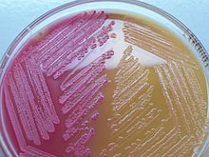
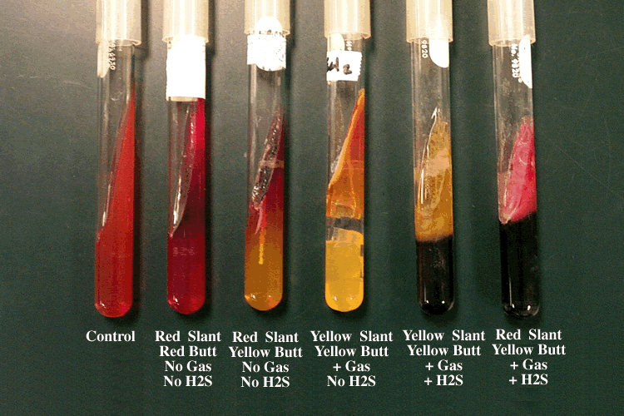
MaConkey Agar plate (Lactose fermentation)
S.No | Strain No | Glucose | Lactose | Sucrose | H₂S | Gas producing
1 | GSA101 | - | - | - | - | -
2 | GSA102 | - | - | - | - | -
3 | GSA103 | + | - | - | - | -
4 | GSA104 | + | - | - | - | -
5 | GSA106 | - | - | - | - | -
6 | GSA108 | - | - | - | - | -
7 | GSA109 | - | - | - | - | -
8 | GSA110 | - | - | - | - | -
9 | GSA112 | + | - | - | - | -
10 | GSA113 | - | - | - | - | -
11 | GSA114 | - | - | - | - | -
12 | GSA117 | - | - | - | - | -
13 | GSA119 | - | - | - | - | -
Triple Sugar Iron

Slide 22
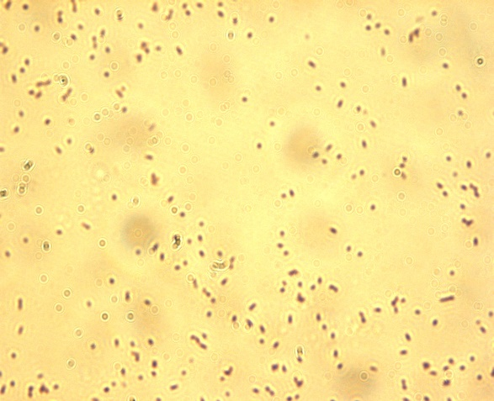
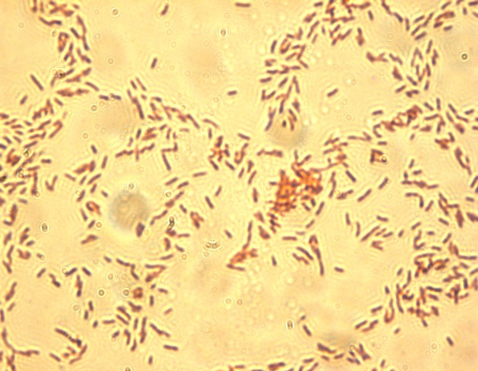
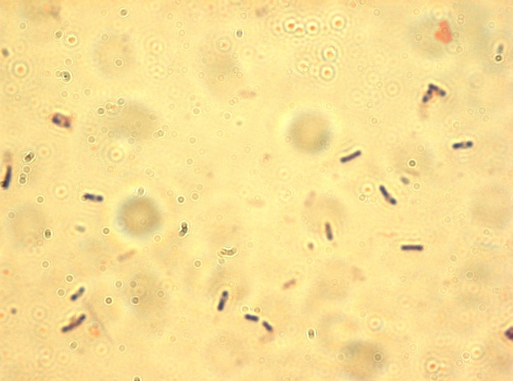
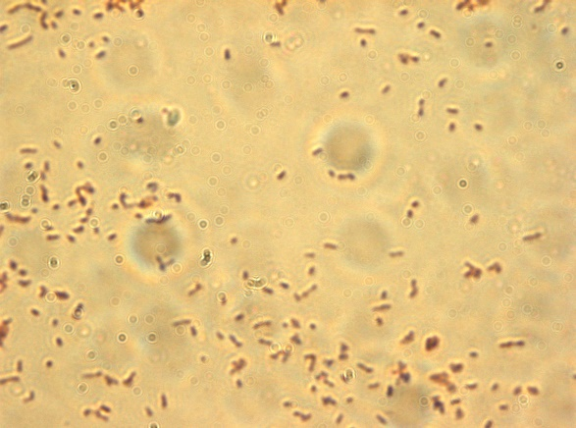
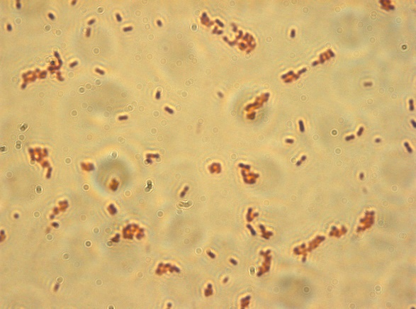
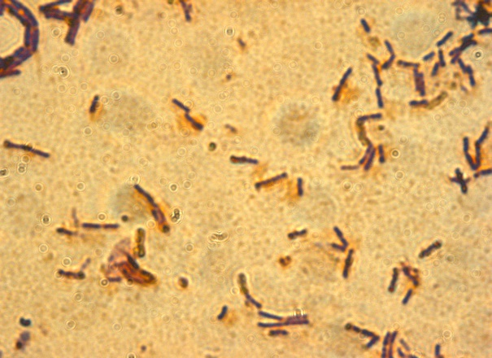
Bacterial strains with Gram Positive and Gram Negative
GSA101- Gram Negative ( light red rods)
GSA102- Gram Negative ( Cocci Red rods)
GSA104- Gram Positive (Dark blue rods)
GSA108- Gram Negative ( Red small rods)
GSA110-Gram Negative ( Red rods)
GSA112- Gram Positive (Blue rods)

Slide 23
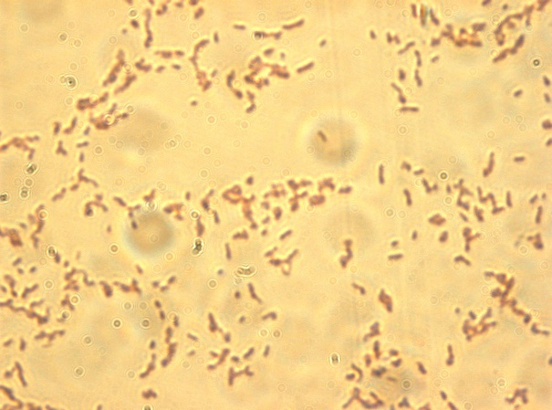
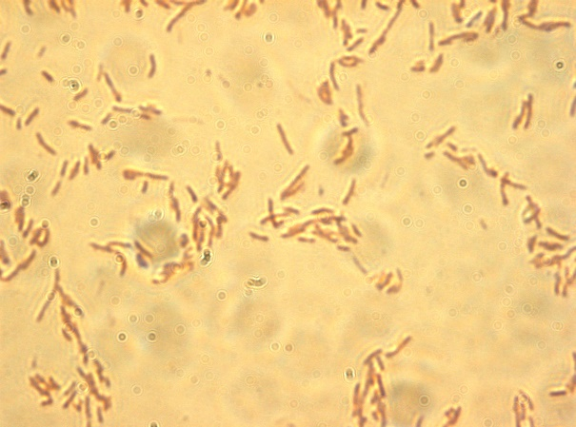
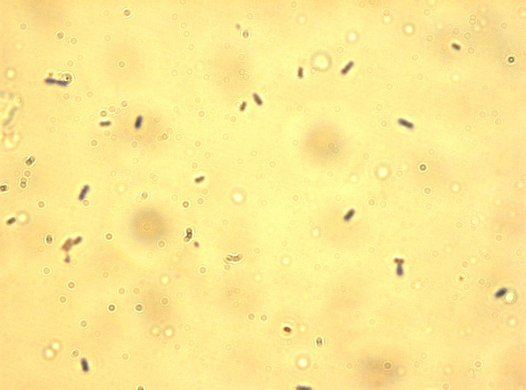
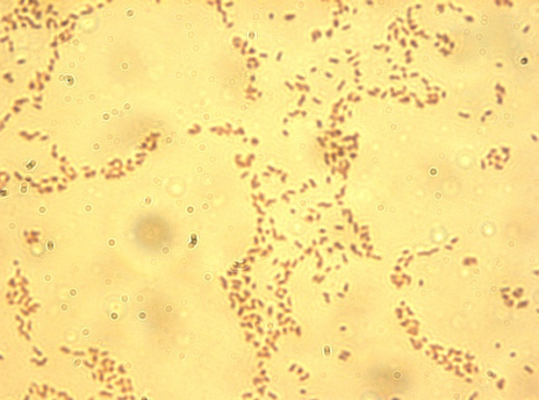
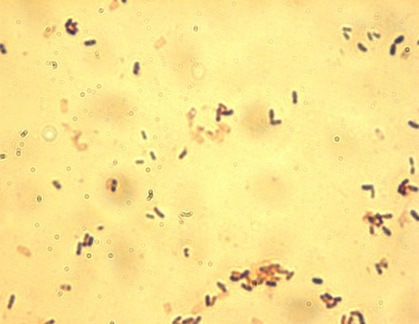
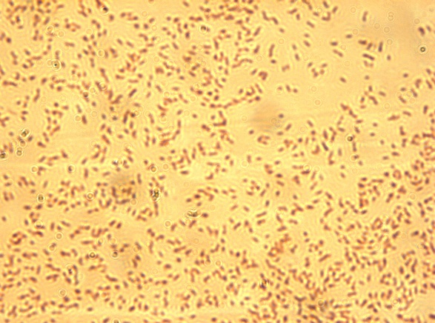
GSA114- Gram Negative (Light red small rods)
GSA117- Gram Negative ( (Light red rods)
GSA103- Gram positive (dark blue rods
GSA106- Gram negative (red rods)
GSA109- Gram positive (blue rods)
GSA113- Gram negative (light red rods)

Slide 24
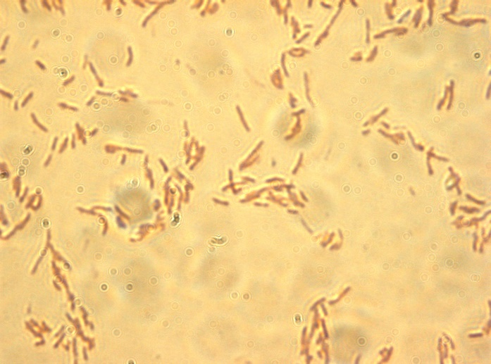
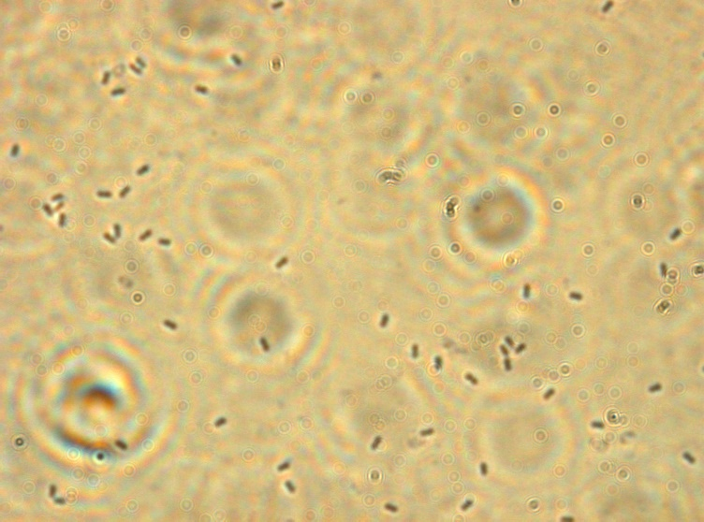
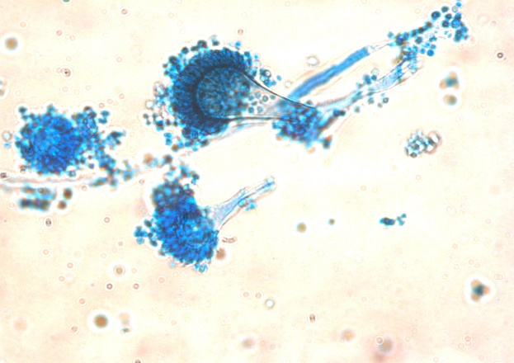
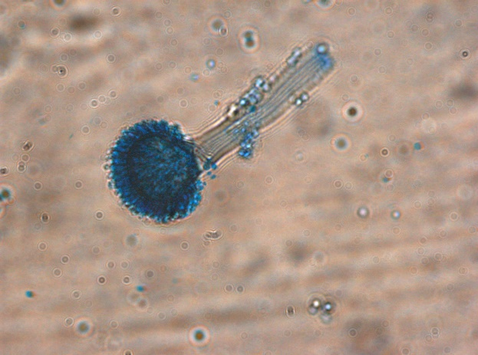
GSA119- Gram negative (red rods)
GSA107- Gram positive (blue rods)
Fungal strains
A. Tamarri
A. Nidulans

Slide 25
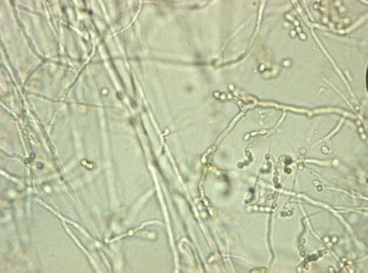
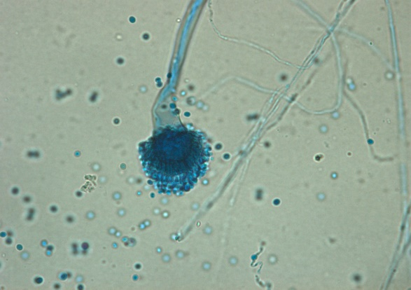
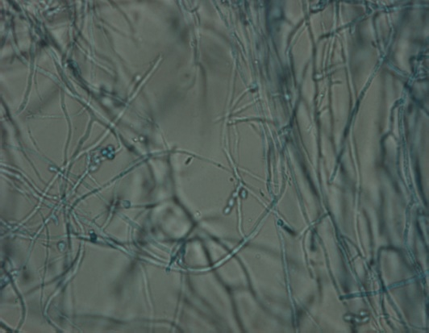
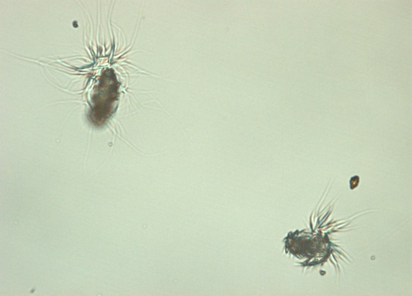
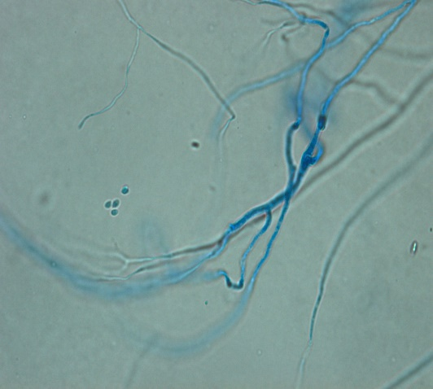
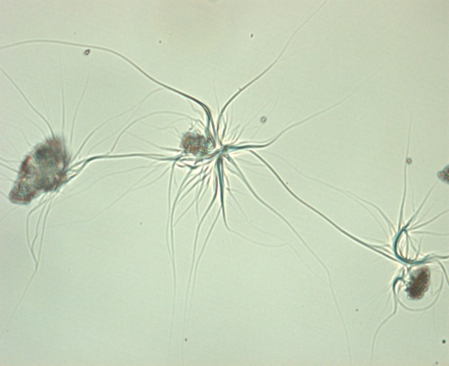
A.versicolor_20x
Acremonium terricola_20x
Scopoularisis species_20x
A.flavus_20x
Scopoularisis species_20x
Acremonium terricola_40x
Smith’s Introduction to Industrial Mycology-Seventh Edition

Slide 26
Observation for sporulation:
S. No | Strain Name | Days | 1 | 2 | 3 | 4 | 5 | 6 | 7 | 8 | 9
 |  | Hours | 24 | 48 | 72 | 96 | 120 | 144 | 168 | 168 | 216
1. 2. 3. 4. 5. 6. 7. | S1051 S1052 S2051 S3051 C3052 C4051 C4052 | SOIL1 SOIL1 SOIL2 COFF1 COFF1 COFF2 COFF2 | + + + + + + + | ++ +++ + ++ ++ + + | +++ +++ + +++ +++ + + | +++ ++++ + +++ +++ ++ + | +++ +++++ + ++++ +++ +++ + | +++++ - + +++++ +++++ +++ + | - - + - - +++ +++ | - - + - - +++ +++ | - - + - - ++++ ++++
8. 9. 10. 11. 12. | S1121 S1122 S2121 C3121 C4121 | SOIL1 SOIL1 SOIL2 COFF1 COFF2 | + + + + + | + ₊₊ + + + | + ₊₊ + + + | + +++ + + + | + +++ + ₊₊ + | + +++ + ₊₊ + | ++ +++ + +++ + | ++ +++ + +++ + | ++++ +++++ + ++++ +
SOIL1:Soil on surface near to coffee plantation. SOIL2: Soil 15cm depth to the surface of coffee plantation. COFF1:Coffee pulp dumps 15cm depth.COFF2: Coffee pulp dump-top. Less growth: +; Less mycelium: ++; Filamentous mycelium: +++; Less spore related: ++++; Clear spore related: +++++;
.

Slide 27
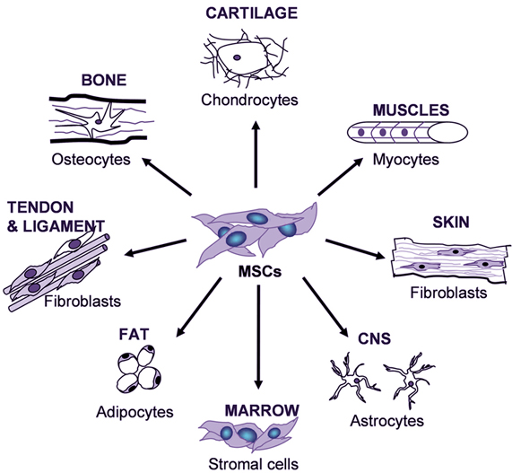
Example Cartilage cells
Isolation of the Mammalian cells
Mesenchymal stem cells, or MSCs, are multipotent stromal cells that can differentiate into a variety of cell types, including: osteoblasts (bone cells), chondrocytes (cartilage cells), myocytes (muscle cells) and adipocytes (fat cells).
Wikipedia Source

Slide 28
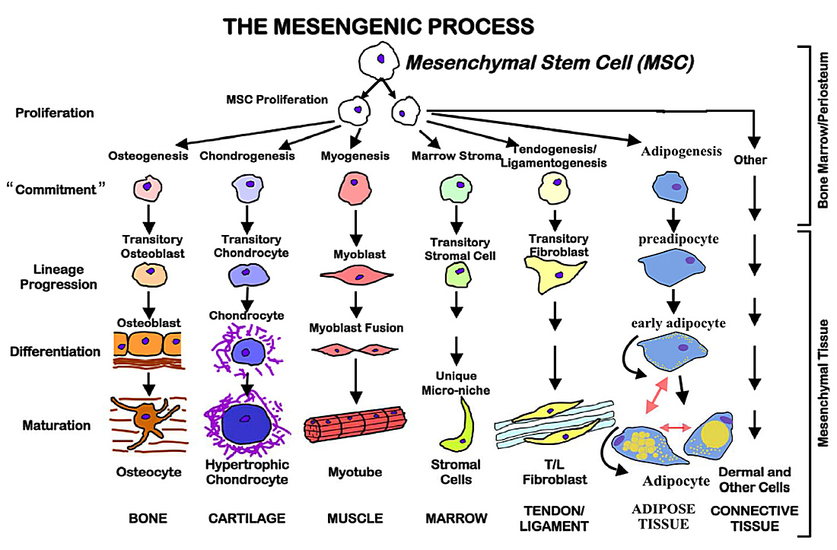
Easy isolation, high expansion, reproducible

Slide 29
Cartilage regeneration
Complete Medium (DMEM)
Chondrogenic Medium (CM)
Peel off native rat cartilage
Transforming growth factors (TGFβ3)
Insulin, Transferring, Selenium (ITS) Dexamethasone
Ascorbic acid
Proline
Treatment with Collagenase (2-3 times)
Tissue processing Microtome
Paraffin sections
Isolation of cells
Hematoxylin and Eosin
Toluidine Blue
DMEM
NaHCo₃
100X PSG
Fetal calf serum (FCS)
Safranin O
Alcian blue
Incubator 37 ºC ; 5% CO₂
Molecular characterization
SEM analysis

Slide 30
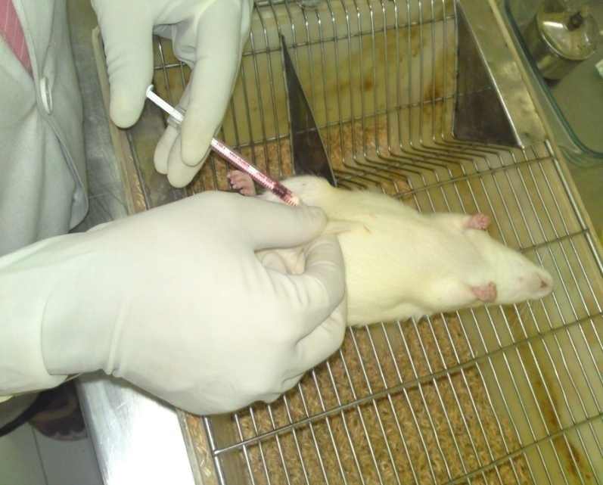



WISTER RAT
Anesthesia : Pentobarbital 25mg/200gms
Cartilage: Intraperitonial area
Cartilage
Wister rat male
Age: 50 days old
Cartilage collection in DMEM medium

Slide 31
Live Image of Primary Cultures by Inverted Microscopy
a
b
0th Day
2nd Day
c
d
3rd Day
4th Day
e
f
5th Day
6th Day

Slide 32
g
h
7th Day
8th Day
Primary chondrocytes cultures, grown in tissue culture flasks containing complete culture medium. (a) First day of chondrocytes seeded on the DMEM medium having the round shape cells (b) Second day they starting the proliferation of primary chondrocytes. (c) Third day, some of the primary chondrocytes differentiated and their shape changes into spindle shape. (d) Fourth day observation, the primary chondrocytes had confluency in the flask having slight spindle shape cells intersecting with one another. (e) Fifth day observation, the primary chondrocytes look fibroblast like arranging themselves in bundles intersecting one another. (f) Sixth day, cell lineage was observed. (g) Seventh day differentiated cell can be observed. (h) Eight day, the cells thawed 90-95 % confluency. All experiments were observed at 20x magnification.

Slide 33

PCR Osteoblast (MC3T3), Primary Culture, and Fibroblast (NIH3T3) Cell lines
Lanes
1
2
3
4
5
6
7
8
9
10
11
L
CI
CI
CI
CII
CII
CII
G
G
G
L
Lane 1 : 100 bp ladder
Lane 2 : MC3T3 (Osteoblast)
Lane 3 : Primary culture
Lane 4 : NIH3T3 (Fibroblast)
Lane 5 : MC3T3 (Osteoblast)
Lane 6 : Primary culture
Lane 7 : NIH3T3 (Fibroblast)
Lane 8 : MC3T3 (Osteoblast)
Lane 9 : Primary culture
Lane 10 : NIH3T3 (Fibroblast)
Lane 11 : 100 bp ladder
L- 100 bp Ladder
CI- Collagen-I
CI- Collagen-I
Rat type II collagen ( 228 bp), upstream primer 5'-tcataggacctaaaggacct-3', downstream primer 5'-tctcgtcaaatcctccagcc-3‘
Mouse type I collagen (761 bp), upstream primer 5’ gaggcataaagggtcatcgtgg-3’, downstream primer 5’-cattaggcgcaggaaggtcagc-3’.
3. Rat (GAPDH) ( 452 bp), upstream primer 5'-accacagtccatgccatcac-3', downstream primer 5'-tccaccaccctgttgctgta-3‘
CII- Collagen-II
CII- Collagen-II
G- GAPDH
Rx₂- Runx2
G- GAPDH

Slide 34



Overview-Rat Cartilage Regeneration
Male Wister rat cartilage tissue
Expanded confluent primary chondrocytes
Isolation of primary
in completed medium
chondrocytes by
enzymatic digestion
Tissue
culture
inserts
with
membrane
Developed
in vitro
scaffold free cartilage rat
tissue
Cells
with
After 30 days in
complete
chondrogenic medium
DMEM
Chondrogenic
medium
for
cartilage
generation
In vitro scaffold free autologous cartilage generation in tissue culture inserts

Slide 35

A Typical Cell

Slide 36


CHLOROPLASTS
Green organelles that make food
found only in plant cells

Slide 37


CHLOROPHYLL
A green pigment that gives leaves & stems their color
Captures sunlight energy that is used to produce food called glucose
Glucose is a type of sugar

Slide 38

MITOCHONDRIA
Organelles that release energy from food
This energy is released by breaking down food into carbon dioxide
Powerhouse supply of (ATP) they release energy from food
Some muscle cells have 20,000 mitochondria

Slide 39

RIBOSOMES
Make proteins
Float freely or attached to the endoplasmic reticulum (ER)
Ribosomes are made in the nucleolus
Nucleus:
1. It is a large spherical structure present in the cell.
2. It is bounded by nuclear envelope.
3. It contains chromosomes.
4. It is rich in DNA, the genetic material.
Nucleolus:
1. It is very small and is present inside the nucleus.
2. It has no limiting membrane.
3. It does not possess any chromosome, but is organized on one chromosome (Nucleolar organiser).
4. It is rich in RNA.
5. It is involved in ribosome synthesis.

Slide 40


ENDOPLASMIC RETICULUM
A series of folded membranes that move materials (proteins) around in a cell
like a conveyor belt
Smooth ER – ribosomes not attached to ER
Rough ER – ribosomes attached to ER

Slide 41

GOLGI BODIES
Stacked flattened membranes
Sort and package macromolecules like proteins and lipids synthesis from cell.

Slide 42

VACUOLES
Temporary storage spaces
Store food, water, waste

Slide 43
LYSOSOMES (LI suh sohmz)
The word "lysosome" is Latin for "kill body."
The purpose of the lysosome is to digest things. They might be used to digest food or break down the cell when it dies.
Break down food molecules, cell wastes & worn out cell parts

Slide 44
FROM CELL TO ORGANISM
Cell
The basic unit of life
Tissue
Group of cells working together
Organ
Group of tissues working together
Organ System
Group of organs working together
Organism
Any living thing made of 1 or more cells

Slide 45

Cell Function like a Chemical Factory
1- Nucleus
2- Chromosomes
7- ER
3- Mitochondria
5- Chloroplasts
4- Ribosomes
8- Cell Membrane
6- Vacuoles
NET SOURCE

Slide 46

NAME THE ORGANELLE
Small Quiz
a. Nucleus
c. Golgi body
b. Chloroplast
d. Mitochondria

Slide 47

DNA
Structure
Deoxyribonucleic acid (DNA) is a molecule that encodes the genetic instructions used in the development and functioning of all known living organisms

Slide 48
DNA Structure
DNA consists of two molecules that are arranged into a ladder-like structure called a Double Helix.
A molecule of DNA is made up of millions of tiny subunits called Nucleotides.
Each nucleotide consists of:
Phosphate group
Pentose sugar
Nitrogenous base

Slide 49
Nucleotides
Phosphate
Nitrogenous
Base
Pentose
Sugar

Slide 50
Nucleotides
The phosphate and sugar form the backbone of the DNA molecule, whereas the bases form the “rungs”.
There are four types of nitrogenous bases.

Slide 51
Nucleotides
Adenine (A)
Thymine (T)
A
T
Adenine
Thymine
Cytosine (C)
C
G
Guanine (G)
Cytosine
Guanine

Slide 52
Nucleotides
Each base will only bond with one other specific base.
Adenine (A)
Thymine (T)
Cytosine (C)
Guanine (G)
Form a base pair.
Form a base pair.

Slide 53
DNA Structure
Because of this complementary base pairing, the order of the bases in one strand determines the order of the bases in the other strand.

Slide 54
A
T
C
G
T
A
C
G
A
T
G
C
T
A

Slide 55
DNA Structure
To crack the genetic code found in DNA we need to look at the sequence of bases.
The bases are arranged in triplets called codons.
A G G - C T C - A A G - T C C - T A G
T C C - G A G - T T C - A G G - A T C

Slide 56
DNA Structure
A gene is a section of DNA that codes for a protein.
Each unique gene has a unique sequence of bases.
This unique sequence of bases will code for the production of a unique protein.
It is these proteins and combination of proteins that give us a unique phenotype.

Slide 57
RNA AND PROTEIN SYNTHESIS

Slide 58
How your cell makes very important proteins
The production (synthesis) of proteins.
3 phases:
1. Transcription
2. RNA processing
3. Translation
DNA → RNA → Protein

Slide 59
DNA → RNA → Protein
Nuclear
membrane
DNA
Transcription
Pre-mRNA
Eukaryotic Cell
RNA Processing
mRNA
Ribosome
Translation
Protein

Slide 60
Before making proteins, Your cell must first make RNA
Question:
How does RNA (ribonucleic acid) differ from DNA (deoxyribonucleic acid)?

Slide 61
RNA differs from DNA
1. RNA has a sugar ribose
DNA has a sugar deoxyribose
2. RNA contains uracil (U)
DNA has thymine (T)
3. RNA molecule is single-stranded
DNA is double-stranded

Slide 62


Slide 63
1. Transcription
Then moves along one of the DNA strands and links RNA nucleotides together.
Nuclear
membrane
DNA
Transcription
Pre-mRNA
Eukaryotic Cell
RNA Processing
mRNA
Ribosome
Translation
Protein

Slide 64
1. Transcription OR RNA production
RNA molecules are produced by copying part of DNA into a complementary sequence of RNA
This process is started and controlled by an enzyme called RNA polymerase.

Slide 65
1. Transcription
DNA
RNA Polymerase
pre-mRNA

Slide 66
Types of RNA
Three types of RNA:
A. messenger RNA (mRNA)
B. transfer RNA (tRNA)
C. ribosome RNA (rRNA)
Remember: mRNA & tRNA produced in the nucleus!

Slide 67
mRNA
Carries instructions from DNA to the rest of the ribosome.
Tells the ribosome what kind of protein to make
Acts like an email from the principal to the cafeteria lady.

Slide 68
A. Messenger RNA (mRNA)
start
codon
A
U
G
G
G
C
U
C
C
A
U
C
G
G
C
G
C
A
U
A
A
mRNA
codon 1
codon 2
codon 3
codon 4
codon 5
codon 6
codon 7
protein
methionine
glycine
serine
isoleucine
glycine
alanine
stop
codon
Primary structure of a protein
aa1
aa2
aa3
aa4
aa5
aa6
peptide bonds

Slide 69



If the cell is a school…
Nucleolus is the principal’s office
Nucleus is the school office
mRNA is the email from the principal to the cafeteria lady
Ribosomes are the cafeteria ladies
DNA is the principal
PROTEINS

Slide 70
rRNA
Part of the structure of a ribosome
Helps in protein production
tRNA
A go-getter.
Gets the right parts to make the right protein
according to mRNA instructions

Slide 71
B. Transfer RNA (tRNA)
amino acid
attachment site
methionine
amino acid
Methionine is the first amino acids incorporated into a protein chain in both prokaryotes and eukaryotes.
Initiator tRNAs are special tRNAs recognizing the AUG (GUG) start codons in prokaryotes and eukaryotes.
U
A
C
anticodon

Slide 72
2. RNA Processing
Nuclear
membrane
DNA
Transcription
Pre-mRNA
Eukaryotic Cell
RNA Processing
mRNA
Ribosome
Translation
Protein

Slide 73
2. RNA Processing
Introns are pulled out and exons come together.
End product is a mature RNA molecule that leaves the nucleus to the cytoplasm.
Introns bad…… Exons good!

Slide 74

2. RNA Processing
pre-RNA molecule
exon
intron
exon
intron
exon
intron
intron
exon
exon
exon
splicesome
splicesome
exon
exon
exon
Mature RNA molecule

Slide 75
Ribosomes
Large
subunit
P
Site
A
Site
mRNA
A
U
G
C
U
A
C
U
U
C
G
Small subunit

Slide 76
3. Translation - making proteins
Nuclear
membrane
DNA
Transcription
Pre-mRNA
Eukaryotic Cell
RNA Processing
mRNA
Ribosome
Translation
Protein

Slide 77
3. Translation
Three parts:
1. initiation: start codon (AUG)
2. elongation:
3. termination: stop codon (UAG)
Let’s make a PROTEIN!!!!.

Slide 78
3. Translation
Large
subunit
P
Site
A
Site
mRNA
A
U
G
C
U
A
C
U
U
C
G
Small subunit

Slide 79
Initiation
aa2
aa1
2-tRNA
1-tRNA
G
A
U
anticodon
U
A
C
hydrogen
bonds
A
U
G
C
U
A
C
U
U
C
G
A
codon
mRNA

Slide 80
Elongation
peptide bond
aa3
aa1
aa2
3-tRNA
G
A
A
1-tRNA
2-tRNA
anticodon
U
A
C
G
A
U
hydrogen
bonds
A
U
G
C
U
A
C
U
U
C
G
A
codon
mRNA

Slide 81
aa1
peptide bond
aa3
aa2
1-tRNA
U
A
C
3-tRNA
(leaves)
G
A
A
2-tRNA
G
A
U
A
U
G
C
U
A
C
U
U
C
G
A
mRNA
Ribosomes move over one codon

Slide 82
peptide bonds
aa1
aa4
aa2
aa3
4-tRNA
G
C
U
2-tRNA
3-tRNA
G
A
U
G
A
A
A
U
G
C
U
A
C
U
U
C
G
A
A
C
U
mRNA

Slide 83
peptide bonds
aa1
aa4
aa2
aa3
2-tRNA
4-tRNA
G
A
U
(leaves)
G
C
U
3-tRNA
G
A
A
A
U
G
C
U
A
C
U
U
C
G
A
A
C
U
mRNA
Ribosomes move over one codon

Slide 84
peptide bonds
aa5
aa1
aa2
aa4
aa3
5-tRNA
U
G
A
3-tRNA
4-tRNA
G
A
A
G
C
U
G
C
U
A
C
U
U
C
G
A
A
C
U
mRNA

Slide 85
peptide bonds
aa5
aa1
aa2
aa3
aa4
5-tRNA
3-tRNA
U
G
A
G
A
A
4-tRNA
G
C
U
G
C
U
A
C
U
U
C
G
A
A
C
U
mRNA
Ribosomes move over one codon

Slide 86
aa5
aa4
aa199
Termination
aa3
primary
structure
of a protein
aa200
aa2
aa1
terminator
or stop
codon
200-tRNA
A
C
U
C
A
U
G
U
U
U
A
G
mRNA

Slide 87
End Product
The end products of protein synthesis is a primary structure of a protein.
A sequence of amino acid bonded together by peptide bonds.
aa5
aa4
aa3
aa2
aa199
aa1
aa200

Slide 88
Question: quiz
The anticodon UAC belongs to a tRNA that recognizes and binds to a particular amino acid.
What would be the DNA base code for this amino acid?

Slide 89

Answer:
tRNA - UAC (anticodon)
mRNA - AUG (codon)
DNA - TAC

Slide 90
Adenosine triphosphate (ATP)
The currency of energy carrier
“hooking and unhooking that last phosphate [on ATP] is what keeps the whole world operating.”
(Trefil, 1992, p. 93)

Slide 91
Importance of ATP
Endergonic reactions require energy to proceed.
Coupling an energy-requiring reaction with an energy-yielding reaction can drive endergonic reactions.
ATP is the most common intermediate in coupled reactions.
Endergonic reaction (takes energy) | Exergonic reaction (release energy)
Yield products that are rich in potential energy - organisms | A chemical reaction that releases energy
Energy inward | Cellular respiration
Photosynthesis | Burning of charcoal
Metabolic pathways
Energy coupling the use of energy released from exergonic reactions to drive essential endergonic reactions (crucial ability of all cells)

Slide 92
Energy is usually liberated from the ATP molecule to do work in the cell by a reaction that removes one of the phosphate-oxygen groups, leaving adenosine diphosphate (ADP). When the ATP converts to ADP, the ATP is said to be spent. Then the ADP is usually immediately recycled in the mitochondria where it is recharged and comes out again as ATP.
~ one hundred trillion human cells
~ Each human cell contain 1 billion ATP molecule
For each ATP “the terminal phosphate is added and removed 3 times each minute”
Hundred trillion cells in the average male, about 10²³ ATP molecules normally exist in the body
Example- around 180kg of ATP generated by consuming 2500 calories
Kornberg, Arthur. 1989. For the love of enzymes. Harvard University Press. Cambridge, MA.

Slide 93

Importance of ATP
ATP consists of adenosine (adenine + ribose) and a triphosphate group.
The bonds between the phosphate groups are high energy bonds.
A-P~P~P

Slide 94

Importance of ATP
Phosphates have negative charges.
Takes lots of energy to hold 3 in a row!
Ready to spring apart.
So, ATP is very reactive.

Slide 95

Importance of ATP
A coupled reaction is a system of two reactions linked by an energy shuttle – ATP.
Substrate B is a fuel – like glucose or lipid.
ATP is not a storehouse of energy – used as soon as it’s available.
Biological reaction
Endergonic reactions are frequently found in biological organisms, because the organism needs to assemble complex molecules such as fats and amino acids, etc., Although these reactions use up energy, the organism has the ability to use other types of molecules, such as sugars as fuel. Endergonic reactions can never occur without a power source.

Slide 96

All cells transform energy. They extract energy from their environment and use this energy to convert simple molecules into cellular components.
Food is digested to break it into smaller pieces – no energy production here.
Glycolysis – coupled reactions used to make ATP.
Occurs in cytoplasm
Doesn’t require O₂
Oxidation – harvests electrons and uses their energy to power ATP production.
Only in mitochondria
More powerful

Slide 97
Glycolysis
Glycolysis – the first stage in cellular respiration.
A series of enzyme catalyzed reactions.
Glucose converted to pyruvic acid.
Small number of ATPs made (2 per glucose molecule), but it is possible in the absence of oxygen.
All living organisms use glycolysis.

Slide 98

Glycolysis
Top portion primes the fuel with phosphates.
Uses 2 ATPs
Fuel is cleaved into 3-C sugars which undergo oxidation.
NAD+ accepts e-s & 1 H+ to produce NADH
NADH serves as a carrier to move high energy e-s to the final electron transport chain.
Downward portion produces 2 ATPs per 3-C sugar (4 total).
Net production of 2 ATPs per glucose molecule.

Slide 99

Producing Acetyl-CoA
The 3-carbon pyruvate loses a carbon producing an acetyl group.
Electrons are transferred to NAD+ forming NADH.
The acetyl group combines with CoA forming Acetyl-CoA.
Ready for use in Krebs cycle.

Slide 100

A Little Krebs Cycle History
Discovered by Hans Krebs in 1937
He received the Nobel Prize in physiology or medicine in 1953 for his discovery
Forced to leave Germany prior to WWII because he was Jewish

Slide 101
The Krebs Cycle
Occurs in the matrix of the mitochondrion
Aerobic phase (requires oxygen)
2-carbon acetyl CoA joins with a 4-carbon compound to form a 6- carbon compound called Citric acid

Slide 102
Citric acid (6C) is gradually converted back to the 4-carbon compound
-ready to start the cycle once more
The carbons removed are released as CO₂
-enzymes controlling this process called decarboxylases
The hydrogens, which are removed, join with NAD to form NADH2
-enzymes controlling the release of hydrogen are called dehydrogenases

Slide 103

Step1: Acetyl+Oxaloacetate= Citrate
CoA-SH freed
Enzyme: Citrate Synthase
Step 2: Citrate rearranged to isocitrate
Enzyme:Aconitase
Step 3: Oxidative decarboxylation: Loss of 2 H atoms to NAD+ (forms NADH + H⁺), removal of C as CO₂, isocitrate becomes a-ketoglutarate
Enzyme: Isocitrate DH
Step 4: Succinyl-CoA produced. Oxidative decarboxylation occurs again
Enzyme:a-ketoglutarate DH (multi-enzyme complex)
Step 5: ATP formed via substrate level phosphorylation, Succinyl- CoA becomes succinate
Enzyme: Succinate thiokinase (Succinyl-CoA Synthetase)
+ Nucleoside diphosphate kinase
Step 6: Succinate oxidized to fumarate (FADH2 produced)
Enzyme: Succinate DH
Step 7: Fumarate hydrated to produce malate.
Enzyme: Fumarase
Step 8: Malate is oxidized into oxaloacetate.
Enzyme: Malate DH
Simple form of Krebs Cycle
Nicotinamide adenine dinucleotide (NADH)
Flavin Adenine Dinucleotide (FADH₂)

Slide 104

Basic Steps involved in Krebs cycle
Doran RE, (2010)- Steps of Krebs Cycle

Slide 105


Slide 106

Depending on the presence of oxygen, the pyruvate will either enter a fermentation process (lactic acid or alcohol) or proceed towards the Krebs Cycle.

Slide 107

Fermentation
In the absence of oxygen, the end-product of glycolysis, pyruvate, is used in fermentation.
During glycolysis, all the NAD⁺ becomes saturated with electrons (NADH). When this happens, glycolysis will stop.
2 NADH and 2 ATP produced.
Pyruvate is used as the electron acceptor resetting the NAD⁺ for use in glycolysis.
Animals add extracted electrons to pyruvate forming lactate.
Reversible when oxygen becomes available.
Muscle fatigue
Yeasts, single-celled fungi, produce ethanol.
Present in wine & beer.
Alcoholic fermentation

Slide 108
Some activated carriers in metabolism
Many of the activated carriers are coenzymes that are derived from water-soluble vitamins.

Slide 109

Types of chemical reactions in metabolism
Addition or removal of functional groups Addition of functional groups to double bonds or their removal to form double bonds
Energy Charge Regulates Metabolism. High concentrations of ATP inhibit the relative rates of a typical ATP-generating (catabolic) pathway and stimulate the typical ATP-utilizing (anabolic) pathway.

Slide 110

Lactic acid cycle
Assignment detail pathways
The Cori cycle (also known as Lactic acid cycle), refers to the metabolic pathway in which lactate produced by anaerobic glycolysis in the muscles moves to the liver and is converted to glucose, which then returns to the muscles and is metabolized back to lactate.

